Slide 1
Object Oriented Programming Lecture-18
Polymorphism: Method Overloading, Overloading main()
Prof. Varsha Dange

Slide 2
Polymorphism in Java
Polymorphism in Java is the ability of an object to take many forms.
Polymorphism is a feature of the object-oriented programming language, Java, which allows a single task to be performed in different ways.
polymorphism in java allows us to perform the same action in many different ways.
There are two types of polymorphism in java:
compile-time (static) polymorphism(Method Overloading )
and runtime (dynamic) polymorphism(Method Overriding)

Slide 3
method overloading in Java.
When a class has more than one method having the same name but with different parameter lists, this feature is called method overloading in Java.
Suppose you have a vehicle. When you apply a brake in a vehicle, it stops the vehicle. The method brake() represents the behavior of stopping the vehicle.
The car brake is applied by the leg and the cycle brake is applied by hand. The way of operating is different but the desired behavior is one and the same.
Overloading is one of the ways that Java implements polymorphism .
It is a powerful and very useful feature for increasing the maintainability and readability of code.

Slide 4
method overloading in Java.
When a class has more than one method having the same name but with different parameter lists, this feature is called method overloading in Java.
Overloading is one of the ways that Java implements polymorphism .
It is a powerful and very useful feature for increasing the maintainability and readability of code.

Slide 5
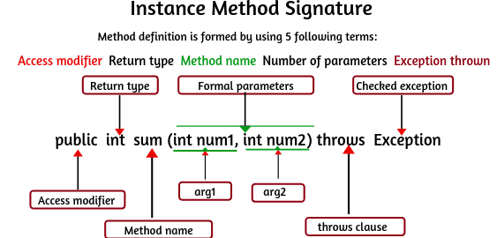
How Java compiler differentiate overloaded methods?
Java compiler differentiates overloaded methods by their signatures.
The signature of a method is defined by its name and list of parameters.
The return type of a method is not part of the method signature.
It does not play any role in resolving methods overloaded.

Slide 6
How Java compiler differentiate overloaded methods?
When a class has multiple methods having the same name with the different parameter list,
the compiler differentiates one method from another method by checking the different number of parameters or types of passed parameters.

Slide 7
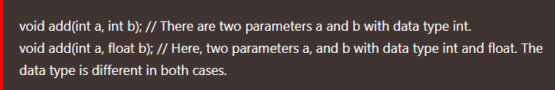
Method overloading rules in Java
1. The method name must be the same.
2. Parameters must be different i.e each overloaded method must take a unique list of parameter types.
The parameters can be changed in one of the following ways.
Data types of Parameters
If we call the method add(10, 20) by passing argument values, JVM invokes the first method.
If we invoke add(10, 20.5f), JVM executes the second method.

Slide 8
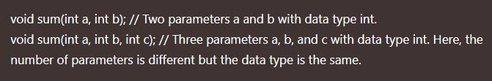
Method overloading rules in Java
b. Number of Parameters
3. Access modifiers can be anything or different. 4. Return Type can be anything or different. 5. Exception thrown can be anything.

Slide 9
How JVM recognizes which overloaded method is called?
When multiple methods are defined with the same name in a class then JVM observes the signature of methods.
Method signature consists of method name along with its method parameters.
On the basis of method signatures, JVM understands both methods are different and decides which appropriate method is to be called.

Slide 10
Features of Method overloading
There are the following features of method overloading in java:
1. The call to overloaded method is bonded at compile time.
2. The concept of method overloading is also known as compile-time polymorphism in java.
3. Method overloading is generally done in the same class.
But it can also be done in the subclass.
You will have to make a relationship between the parent class and child class by using extends keyword for it.
4. Method overloading in Java cannot be done by changing the return type of the method because there may occur ambiguity.
But the overloaded methods can change the return type.

Slide 11
Features of Method overloading
5. The private methods can be overloaded in Java.
6. The final methods can be overloaded in Java.
7. The main method can also be overloaded in Java.
8. Both static and instance methods can be overloaded in Java.

Slide 12
Ways of Method overloading
1. Method overloading by changing number of arguments
we will create two methods, the first method sum() will perform addition of two numbers and second method sum() will perform addition of three numbers by overloading concept.
Example

Slide 13
Ways of Method overloading
2. Method overloading by changing data type of parameters
we will create two methods having the same name but will differ in the data type of parameters.
The first method sub() will receive two integer arguments and the second method sub() will receive two double arguments.
Example

Slide 14
Ways of Method overloading
3. Method overloading by changing sequence of data type of parameters
we will overload methods by changing sequence of data type of parameters.
Example

Slide 15
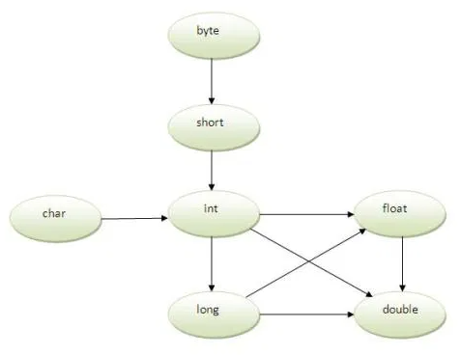
Ways of Method overloading
Method Overloading and Type Promotion:
One type is promoted to another implicitly if no matching datatype is found.
Example
Example of Method Overloading
with Type Promotion in case
ambiguity:
If there are no matching type arguments
in the method, and each method promotes
similar number of arguments, there will be
ambiguity. Example

Slide 16
Java Method overloading done in Subclass
method overloading will be done in the child class or subclass.
We will make a relationship between the parent class and child class by using extends keyword.
Example

Slide 17
method overloading is compile-time polymorphism
Method overloading is one of the way java supports static polymorphism.
For eg- we have two definitions of the same method add() which add method would be called is determined by the parameter list at the compile time. That is the reason this is also known as compile time polymorphism.

Slide 18
Can we overload main() method in Java?
Yes, we can overload the main() method in Java.
A class can have any number of main() methods but JVM calls that main() method that receives string array as an argument only.
Therefore, the execution always starts from public static void main(String[] args) only.
Example

Slide 19
Can we overload main() method in Java?
Yes, we can overload the main() method in Java.
A class can have any number of main() methods but JVM calls that main() method that receives string array as an argument only.
Therefore, the execution always starts from public static void main(String[] args) only.
Example

